Slide 1
Decision Trees

Slide 2
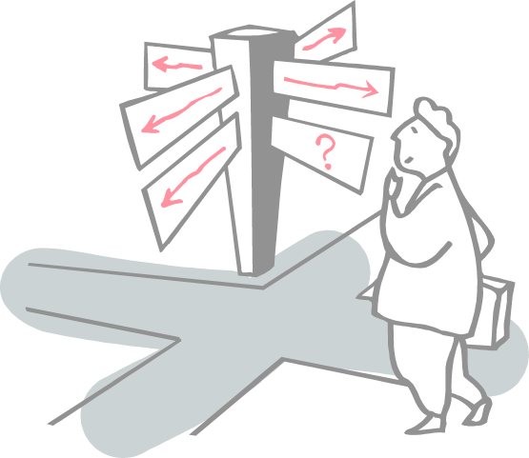
Roadmap
Decision Tree
Important Terminology
ID3
Entropy
Information Gain
Example problems

Slide 3
Decision Tree
Decision tree is a type of supervised learning algorithm (having a pre-defined target variable) that is mostly used in classification problems.
It works for both categorical and continuous input and output variables
Split the population or sample into two or more homogeneous sets (or sub-populations) based on most significant splitter / differentiator in input variables

Slide 4
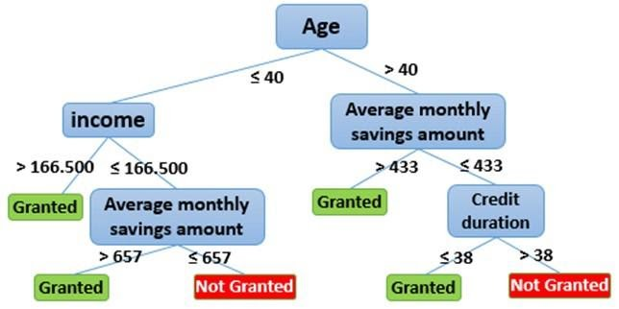
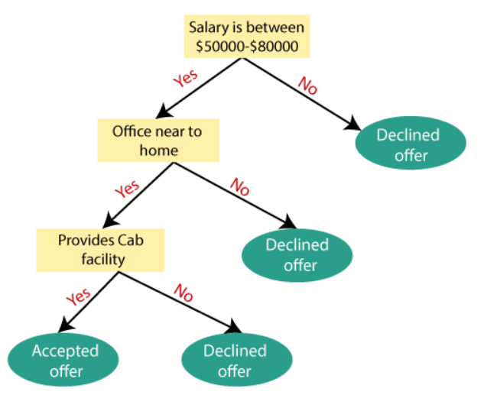
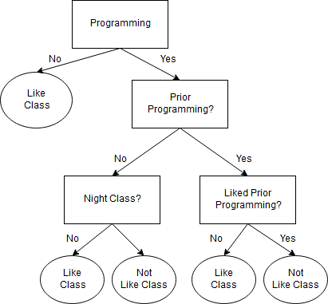
Decision Tree

Slide 5
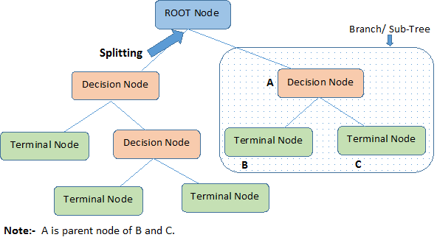
Important Terminology
Root Node: It represents entire population or sample and this further gets divided into two or more homogeneous sets
Splitting: It is a process of dividing a node into two or more sub-nodes
Decision Node: When a sub-node splits into further sub-nodes, then it is called decision node
Leaf/ Terminal Node: Nodes with no children (no further split) is called Leaf or Terminal node
Pruning: When we reduce the size of decision trees by removing nodes (opposite of Splitting), the process is called pruning
Branch / Sub-Tree: A sub section of decision tree is called branch or sub-tree.
Parent and Child Node: A node, which is divided into sub-nodes is called parent node of sub-nodes where as sub-nodes are the child of parent node.

Slide 6
Example – Predict If John will play tennis

Slide 7
Example – Predict If John will play tennis

Slide 8
Example – Predict If John will play tennis

Slide 9
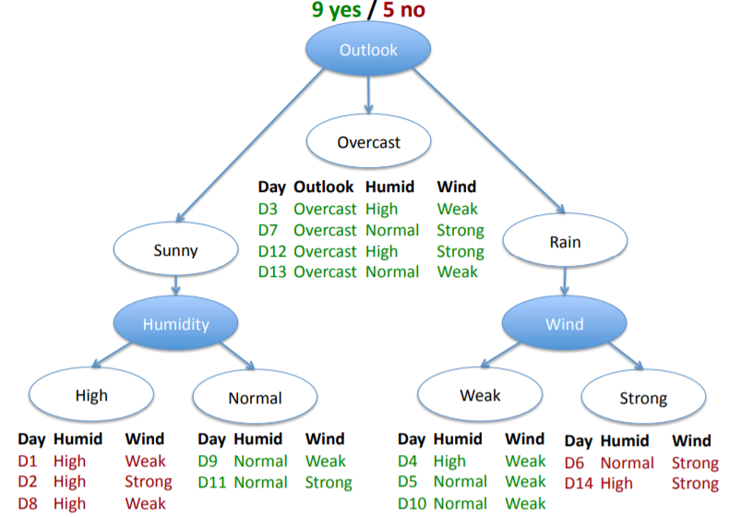
Example – Predict If John will play tennis

Slide 10
Example – Predict If John will play tennis

Slide 11
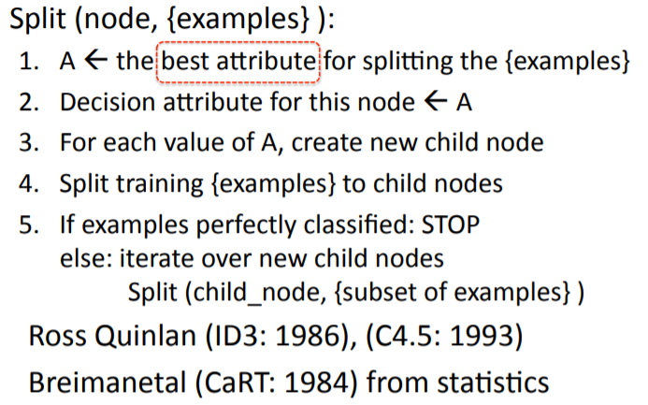
ID3 algorithm (Iterative Dichotomiser 3)
ID3 uses Entropy and Information Gain to construct a decision tree.

Slide 12
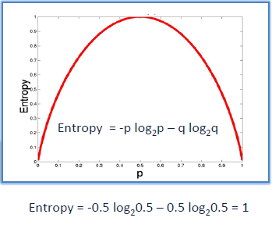
ID3 - Entropy
A decision tree is built top-down from a root node and involves partitioning the data into subsets that contain instances with similar values (homogeneous).
ID3 algorithm uses entropy to calculate the homogeneity of a sample.
If the sample is completely homogeneous the entropy is zero and if the sample is equally divided then it has entropy of one.

Slide 13
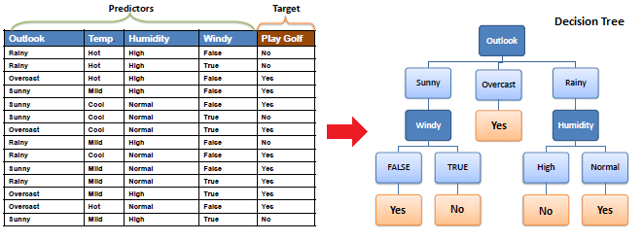
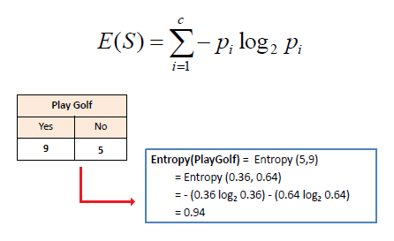
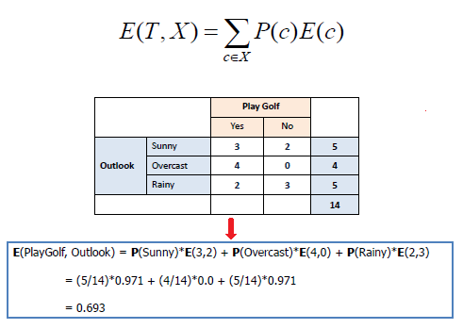
ID3 - Entropy
Entropy using the frequency table of one attribute:
Entropy using the frequency table of two attributes:

Slide 14
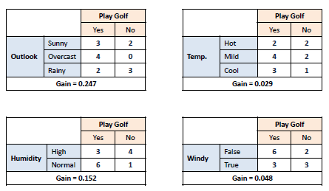
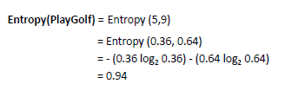
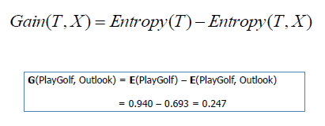
ID3 Steps
Step 2:
The dataset is then split on the different attributes.
The entropy for each branch is calculated. Then it is added proportionally, to get total entropy for the split.
The resulting entropy is subtracted from the entropy before the split.
The result is the Information Gain, or decrease in entropy.
The information gain is based on the decrease in entropy after a data-set is split on an attribute.
Constructing a decision tree is all about finding attribute that returns the highest information gain (i.e., the most homogeneous branches).
Step 1: Calculate entropy of the target.

Slide 15
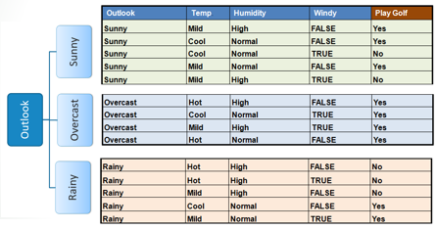
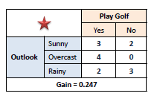
ID3 Steps
Step 3: Choose attribute with the largest information gain as the decision node, divide the dataset by its branches and repeat the same process on every branch.

Slide 16
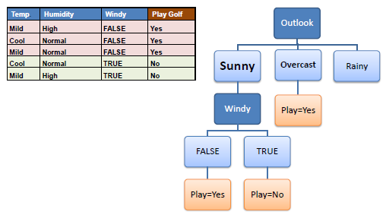
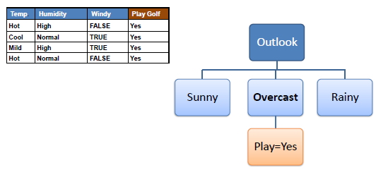
ID3 Steps
Step 4b: A branch with entropy more than 0 needs further splitting.
Step 4a: A branch with entropy of 0 is a leaf node.
Step 5: The ID3 algorithm is run recursively on the non-leaf branches, until all data is classified.

Slide 17
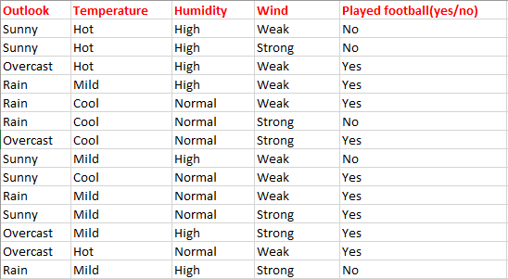
Example Revisited
Consider weather dataset based on which we will determine whether to play football or not.

Slide 18
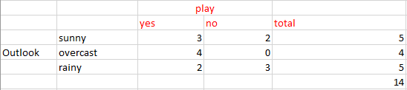
First step - find the parent node for our decision tree
Find the entropy of class variable.
E(S) = -[(9/14)log(9/14) + (5/14)log(5/14)] = 0.94
calculate average weighted entropy E(S, outlook) = (5/14)*E(3,2) + (4/14)*E(4,0) + (5/14)*E(2,3) = (5/14)(-(3/5)log(3/5)-(2/5)log(2/5))+ (4/14)(0) + (5/14)((2/5)log(2/5)-(3/5)log(3/5)) = 0.693
find the information gain [Difference between parent entropy and average weighted entropy ] = IG(S, outlook) = 0.94 - 0.693 = 0.247

Slide 19
First step - find the parent node for our decision tree
Find Information gain for Temperature, Humidity and Windy
IG(S, Temperature) = 0.940 - 0.911 = 0.029
IG(S, Humidity) = 0.940 - 0.788 = 0.152
IG(S, Windy) = 0.940 - 0.8932 = 0.048

Slide 20
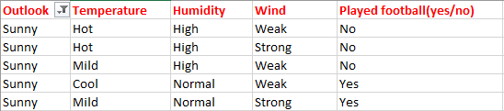
Next step : find the next node in our decision tree
find the node under sunny -- to determine which of the following Temperature ,Humidity or Wind has higher information gain
Calculate parent entropy E(sunny)
E(sunny) = (-(3/5)log(3/5)-(2/5)log(2/5)) = 0.971.

Slide 21
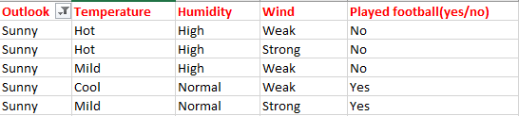
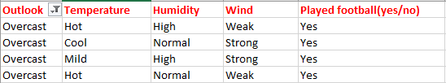
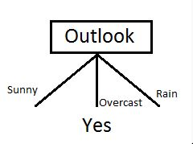
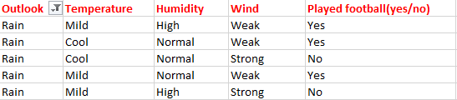
Step 2: select the feature having largest entropy gain
Here it is Outlook. So it forms first node(root node) of our decision tree.
overcast contains only examples of class ‘Yes’ we can set it as yes

Slide 22
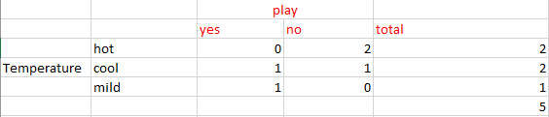
Next Step : find the next node in our decision tree
Calculate information gain of Temperature. IG(sunny, Temperature)
E(sunny, Temperature) = (2/5)*E(0,2) + (2/5)*E(1,1) + (1/5)*E(1,0)=2/5=0.4
IG(sunny, Temperature) = 0.971–0.4 =0.571
Compute IG ,
IG(sunny, Humidity) =
IG(sunny, Wind) =

Slide 23
Next Step : find the next node in our decision tree
Calculate information gain of Temperature. IG(sunny, Temperature)
E(sunny, Temperature) = (2/5)*E(0,2) + (2/5)*E(1,1) + (1/5)*E(1,0)=2/5=0.4
IG(sunny, Temperature) = 0.971–0.4 =0.571
Compute IG ,
IG(sunny, Humidity) = 0.971
IG(sunny, Windy) = 0.020

Slide 24

Next Step : find the next node in our decision tree
IG(sunny, Humidity) is the largest value, So Humidity is the node which comes under sunny.
Play will occur if humidity is normal
and will not occur if it is high

Slide 25
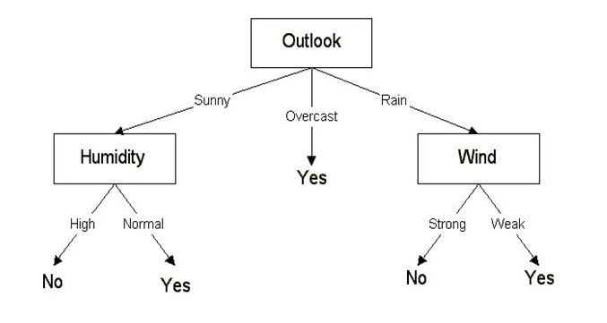
Final Decision Tree

Slide 26
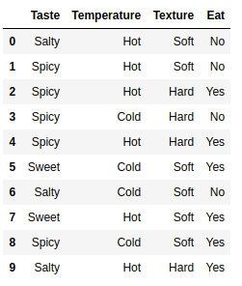
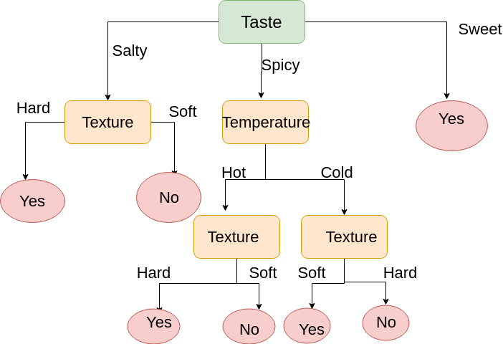
Example 2
https://medium.com/@rakendd/building-decision-trees-and-its-math-711862eea1c0

Slide 27
CART Vs ID3 Vs C4.5

Slide 28
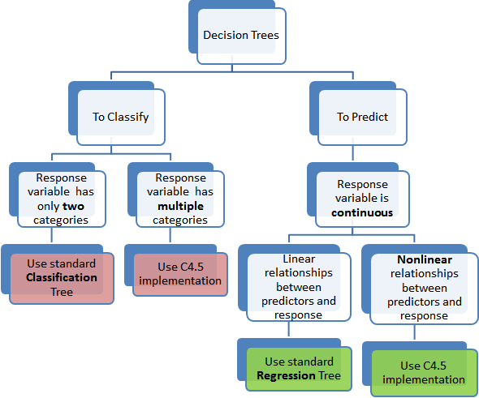
Types of decision trees

Slide 29
References
https://www.analyticsvidhya.com/blog/2016/04/complete-tutorial-tree-based-modeling-scratch-in-python/
http://www.inf.ed.ac.uk/teaching/courses/iaml/2011/slides/dt.pdf
https://medium.com/datadriveninvestor/decision-tree-algorithm-with-hands-on-example-e6c2afb40d38
https://medium.com/@rishabhjain_22692/decision-trees-it-begins-here-93ff54ef134

Slide 30
Thanks

